Slide 1

G.I. Junk Removal
Nishtha Gupta

Slide 2
Summary of Previous Analysis
The team conducted an exploratory data analysis of the data provided by GI Junk and arrived at the following insights:
Revenue per repeat customer is higher than the revenue per new customer
The revenue per client across these cities as well as the revenue per job is consistent across the cities
The conversion rate is the highest for GI Junk Website followed by Google
COGS forms a significant proportion (75-80%) of the costs incurred by GI Junk over the years
A large proportion of the total revenue accrued across the by GI Junk is being spent as employee costs
Based on the discussion with GI Junk team, the following areas were identified for a deep dive analysis:
Enhancing customer acquisition and retention
Improving employee productivity and determining compensation for employees

Slide 3
Background and Objective
The research aims to analyze data and discover trends and opportunities to improve GI Junk's business performance. The flowchart outlines the two main themes and sub-themes the team focused on using to achieve their goals.
Improving business outcomes for GI Junk
Expand Revenue
Reduce Cost
Increase customer acquisition
Reduce customer churn/ improve retention
Improving resource optimization
Improve operational efficiencies

Slide 4
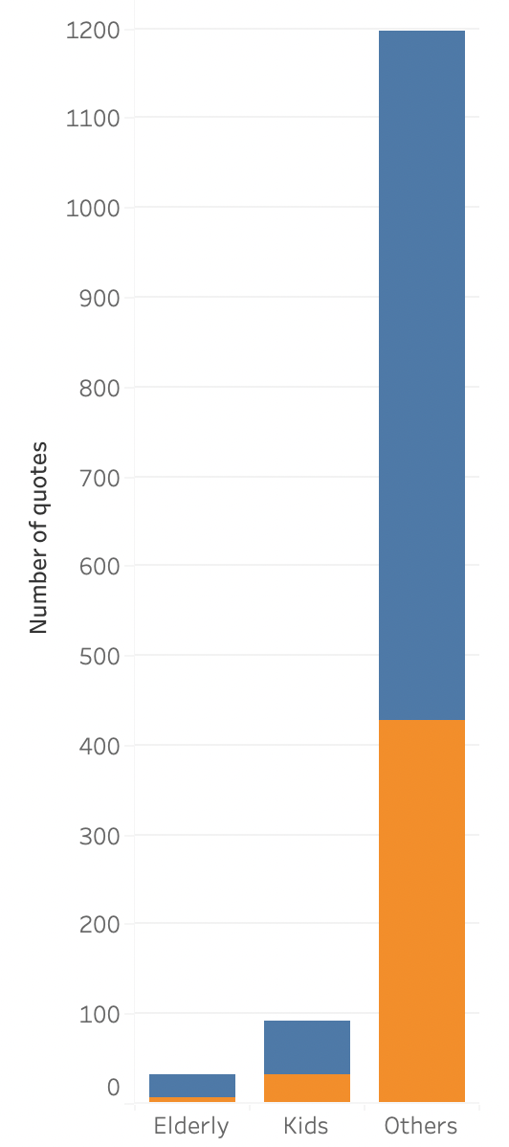
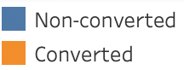
Analysis of Junk Quotes: Identifying Potential Target Customer Segment
Quotes across age groups by type
Words like 'crib', 'swing', and 'baby' indicated kids-related stuff, while 'senior', 'passed away', and 'retired' indicate elderly-related stuff.
Elderly-related quotes made up 2.4% of the total, with 6 out of 31 converted to jobs, generating $10,692 revenue (5.3% of total 2022 revenue)
Kids-related quotes accounted for 7% of the total, with 31 converted to jobs and generating $15,909 (7.9% of 2022 revenue)

Slide 5
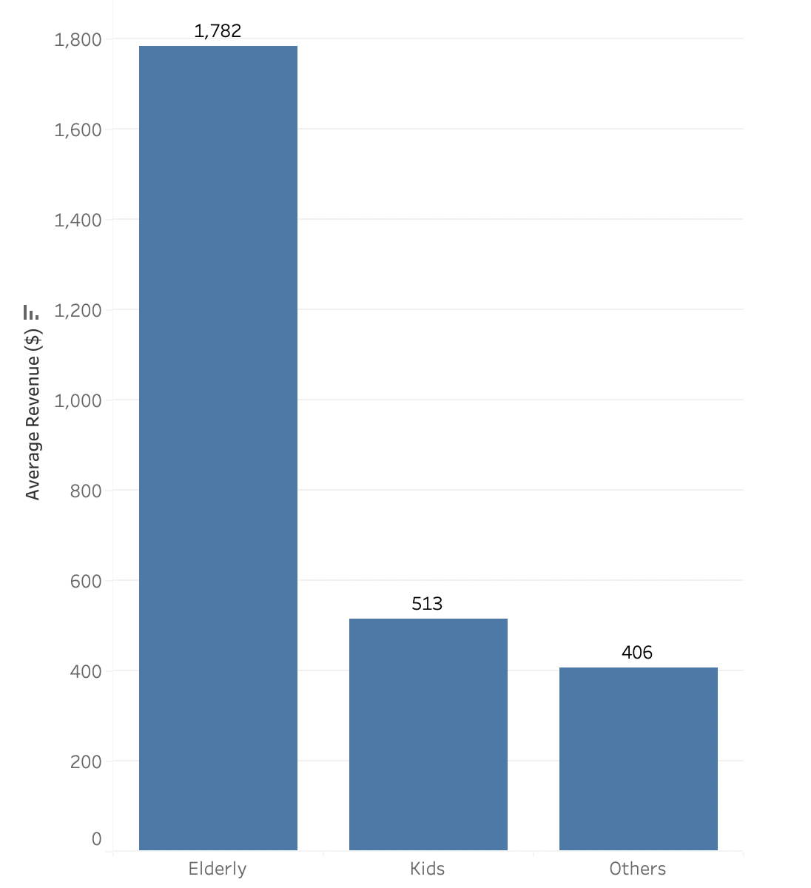
Maximizing Revenue Potential through Targeted Marketing & High-Value Jobs
Average revenue per job across age groups
Elderly and kids-related junk jobs generated higher average revenue per job than other types of jobs
One job related to an elderly hoarder estate clean-up generated the highest revenue among all jobs converted from online quotes in 2022 ($8,654). If we exclude this outlier, the Average Revenue of Elderly is $408.
Targeting customers dealing with the emotional and challenging task of cleaning out estates can attract more customers with high-revenue jobs for GI Junk

Slide 6
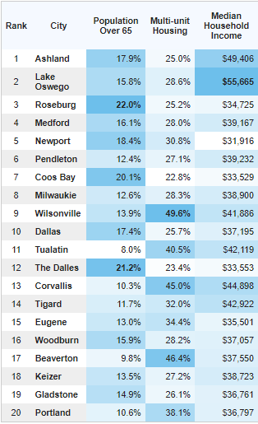
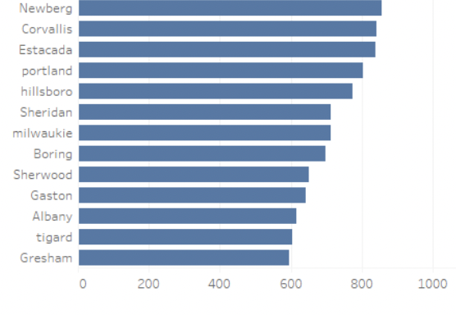
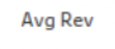
Targeting Elderly Demographics for Revenue Expansion in Oregon Cities
It is seen that junk removal jobs for the elderly customers have a higher average revenue per job, making them potentially a lucrative market
Focus on cities with higher elderly population like Milwaukie, Corvallis, Tigard , and Portland
Adopting marketing strategy specifically targeting the elderly to increase customer base and revenue
Source : CreditDonkey
Notes:
A notable variance was observed in the average revenue generated among 20 cities

Slide 7
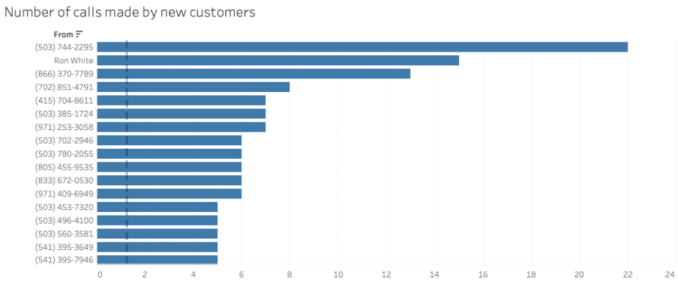
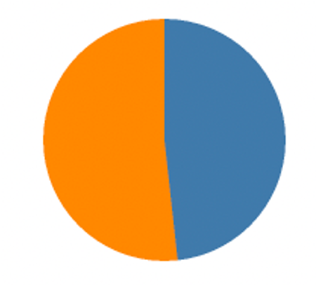



Analyzing GI Junk’s Call Volume
Breakdown of calls by clients to GI Junk
GI Junk gets 6279 calls from clients of which 52% customers proceed with a job while 48% do not proceed with the job
On an average a prospective customer calls GI Junk ~ 1.3 times before they decide to switch to a different junk removal company

Slide 8
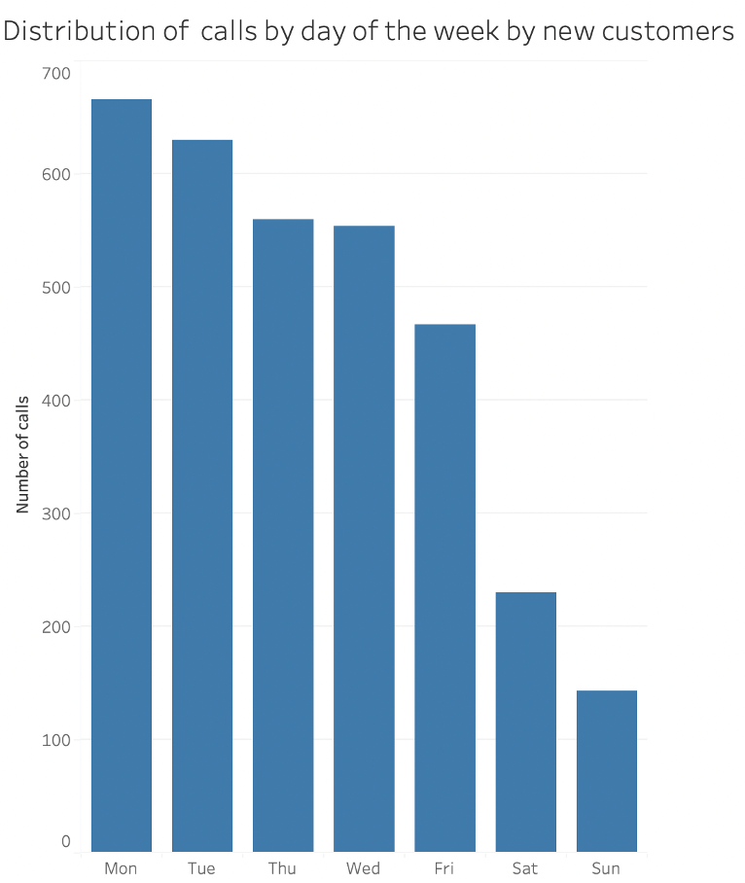
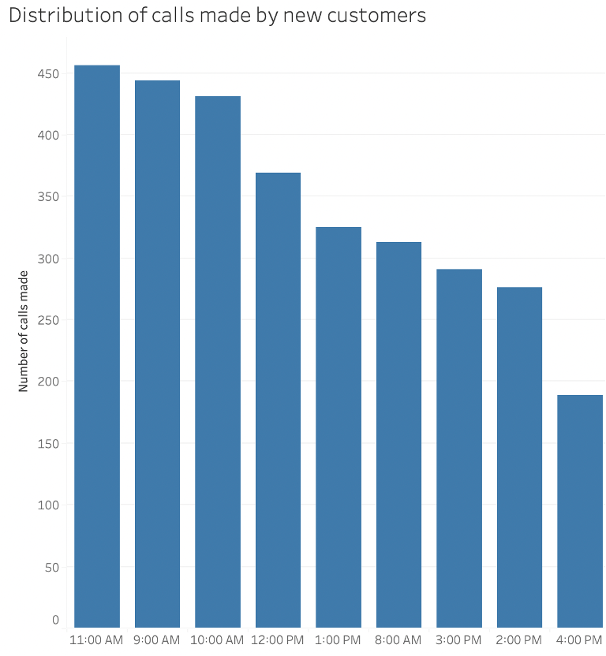
Prospective Customer Inquiries Spike on Weekday Mornings
Distribution of calls by new customers over the week
Distribution of calls by new customers across time of the day
It is seen that a significant number of calls are made by new/ prospective customers over Mondays and Tuesdays
Most of these calls are made between 9:00 AM and 12:00 PM

Slide 9
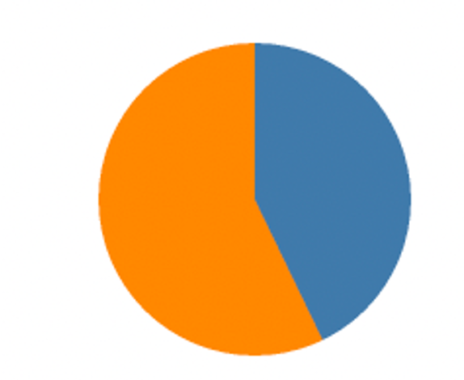

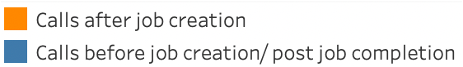
GI Junk Customer Service Team Spends a Significant Proportion of Time in Order Confirmations
Breakdown of calls made by GI Junk to the client
About 57% of the calls are associated with reviewing or confirming orders placed by clients
An automated messaging system that can aid the team in order confirmations will be helpful in leaving time for customer acquisition activities

Slide 10
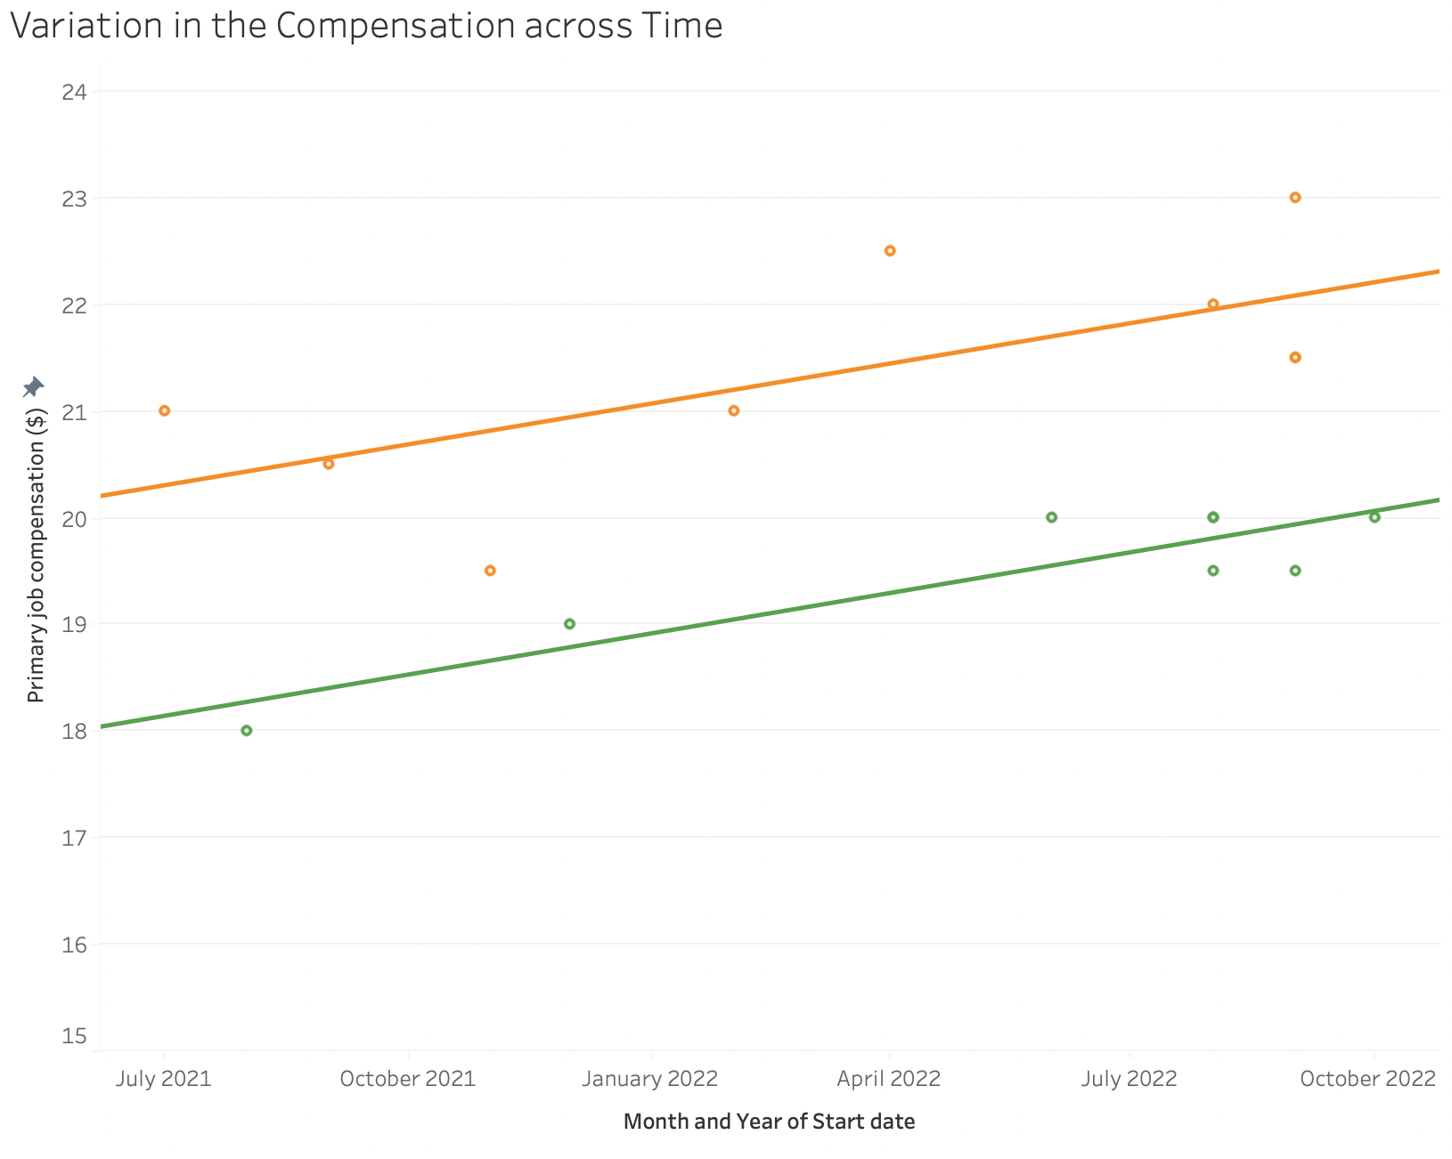
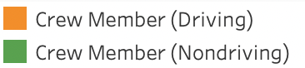
Analyzing the Factors Influencing Crew Incentivization
Variation in Employee Compensation across Time
It is seen that there are two factors influencing crew compensation:
Start date of the crew: The labor cost increased in the US during 2021 and 2022. It is seen that there was a correlation between the month a worker started and their hourly pay, suggesting a linear relationship between the two factors.
Job type of the crew: When comparing crew members who were hired at the same time, the driving crew has an average hourly rate that is $2 higher than the non-driving crew
Notes:
As crew members constitute a major part in GI Junk employee structure, we want to see how to evaluate and incentivize them.
Before we get to evaluate their efficiency, we have to admit that there are two important factors influencing the compensation structure: 1: start date, 2: Job type
As labor gets more and more expensive, it is necessary for us to incentivize the crew members in the right way to increase their efficiency.

Slide 11
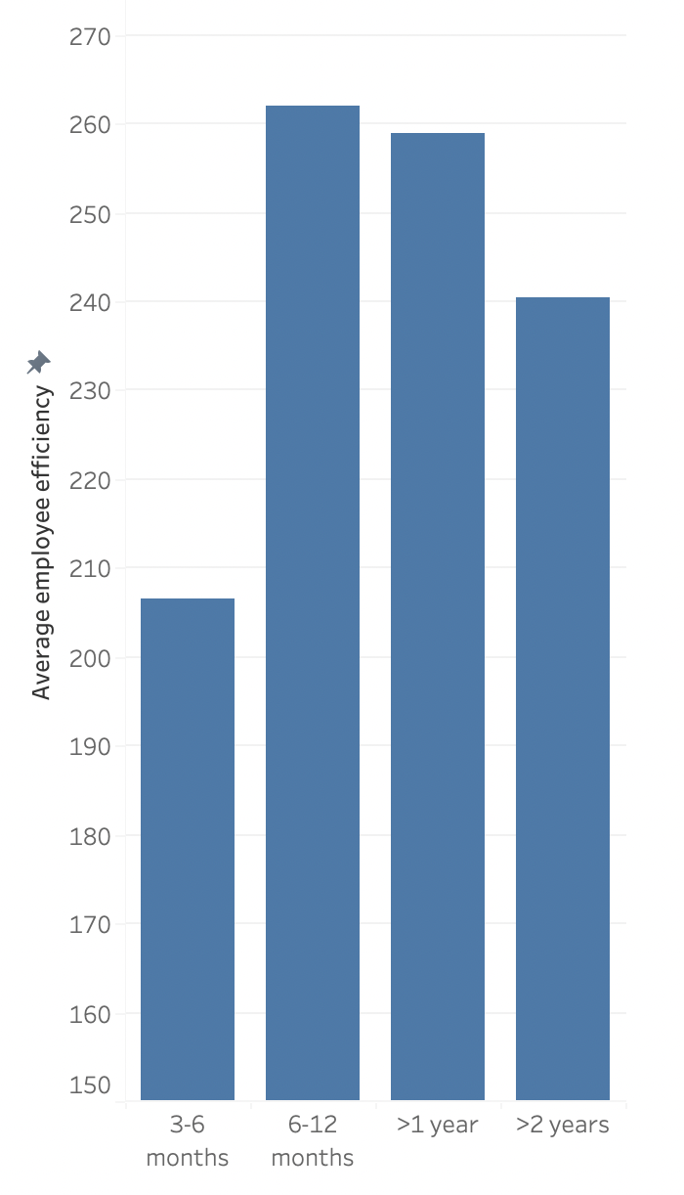
Understanding the Relationship Between Employee Experience and Employee Efficiency
Employee efficiency with change in employee experience
The efficiency of employees as a function of their total tenure at the firm was calculated based on revenue per job per crew, work duration per job, and the number of jobs completed
It was found that most recent hires were least efficient while the efficiency among employees with the highest tenure (over 2 years) was not the highest
Employee training & optimized workflows for the new joinees and a robust incentivization program (bonuses, promotions, employee recognitions) for the experienced may improve efficiency
Notes:
This indicates that experience alone does not necessarily equate to higher efficiency

Slide 12
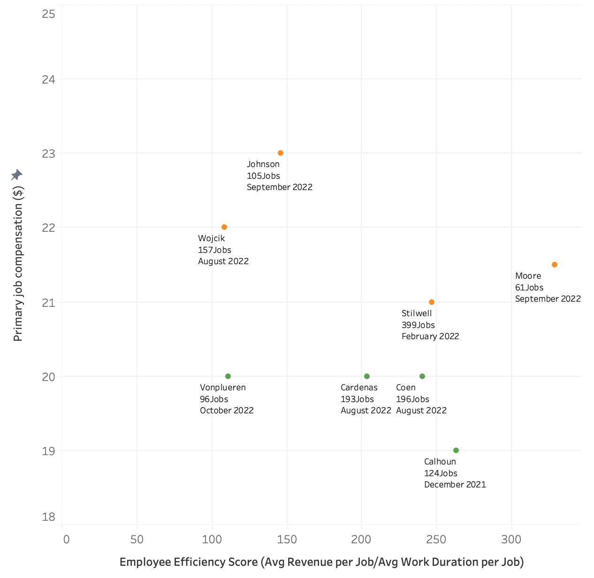
Recalibrating Employee Compensation based on Efficiency Score
Efficiency score vs job compensation of current crew members
To determine which crew members to promote among people of the same hierarchy, an efficiency score can be used
At the end of 2022, it is seen that among the driving crew, Stilwell completed 399 jobs and had a statistically significant high efficiency score
Among the non-driving crew, Coen completed 196 jobs and had statistically significant high efficiency score
Employee compensation and promotion could be based on the efficiency score and customer review scores for each employee

Slide 13
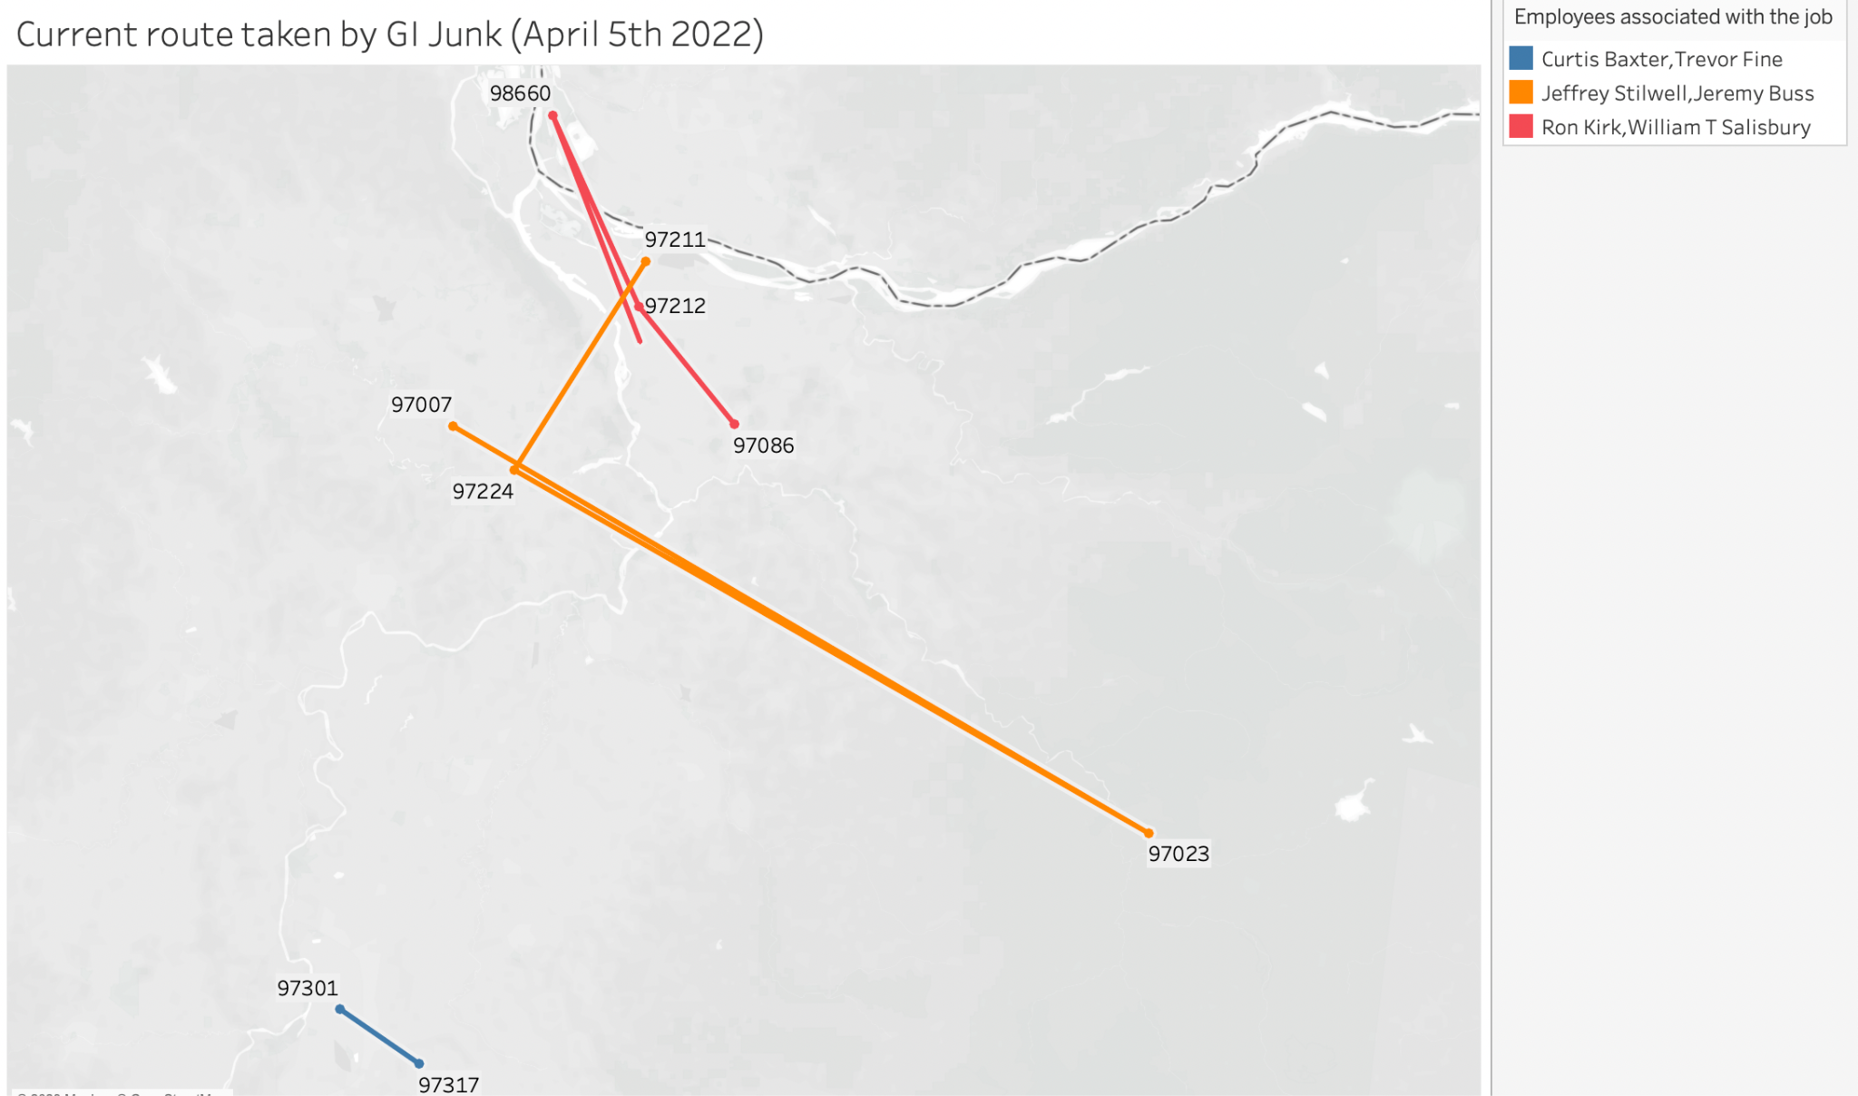
Understanding the Movement of GI Junk's Fleet
GI Junk's current route for covering job locations based on scheduled times is often not the most optimal
It can be observed here that GI Junk team travels from point A to B and then back towards point A to cover the next set of houses
This additional distance increases travel time and decreases efficiency
A
B

Slide 14
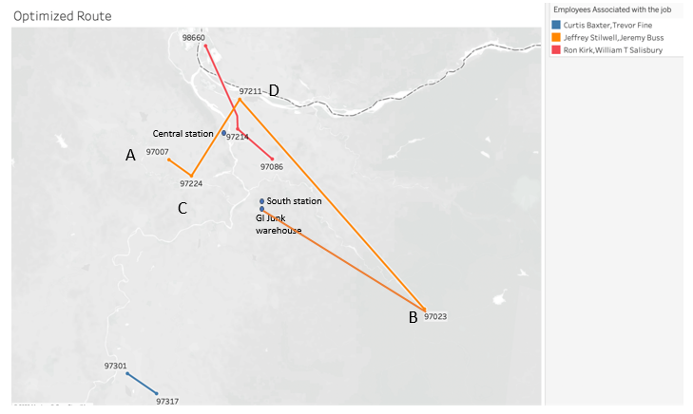
Optimized Route Plan for GI Junk Fleet
The image here shows the optimized alternate route that can be taken by GI Junk to reduce the travel time
GI Junk could potentially save time and fuel by unloading at Central station instead of South station, which is closer to the route between points C and D
By reducing travel time, GI Junk can complete more jobs and potentially increase revenue

Slide 15
Savings Entailed in the Optimized Route
Description | Value
Distance traversed with the current route | 140 miles
Distance traversed with the optimized route | 84 miles
Time taken to cover the current route (assuming an average vehicle speed of 45 miles per hour) | 3 hours
Time taken to cover the optimized route | 2 hours
Time saved by taking the optimized route | 1 hour
Average time taken to complete a 1/4 load job (hour) | 1 hour
Average revenue per 1/4 load job (USD) | 400
Estimated revenue gain (USD)* | 400

Slide 16
Thank You

Slide 17
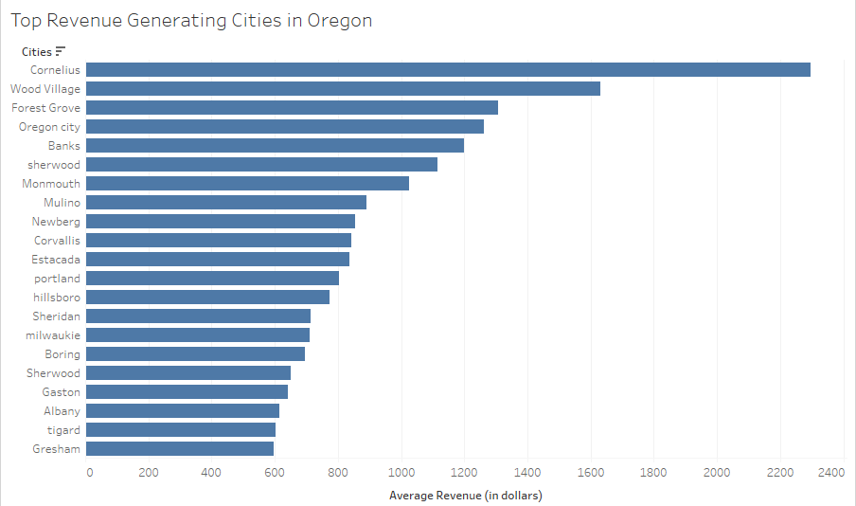
Revenue Analysis: Targeting Expansion in Oregon's Top Cities
Oregon accounts for ~70% of the total revenue GI Junk generates
Notes:
A notable variance was observed in the average revenue generated among 20 cities

Slide 18
Marketing Strategies at Elderly Populated Areas
Direct mail or flyer campaigns: You could create flyers or mailers that highlight your junk removal services and target them to neighborhoods or areas with a high concentration of seniors or retirement communities.
Online advertising: You could run targeted online ads on social media platforms like Facebook or Instagram, or on search engines like Google or Bing. You can target specific age groups or geographic locations to reach seniors and their families.
Referral programs: You could offer referral incentives or discounts to seniors or their children who refer your services to others.
Partnering with senior service organizations: You could establish partnerships with organizations that serve seniors, such as retirement homes, senior centers, or community centers. This could help you reach a wider audience of potential customers.
Word of mouth: Satisfied customers are likely to recommend your services to others, so it's important to provide high-quality service to all customers to build a good reputation in the community.

Slide 19
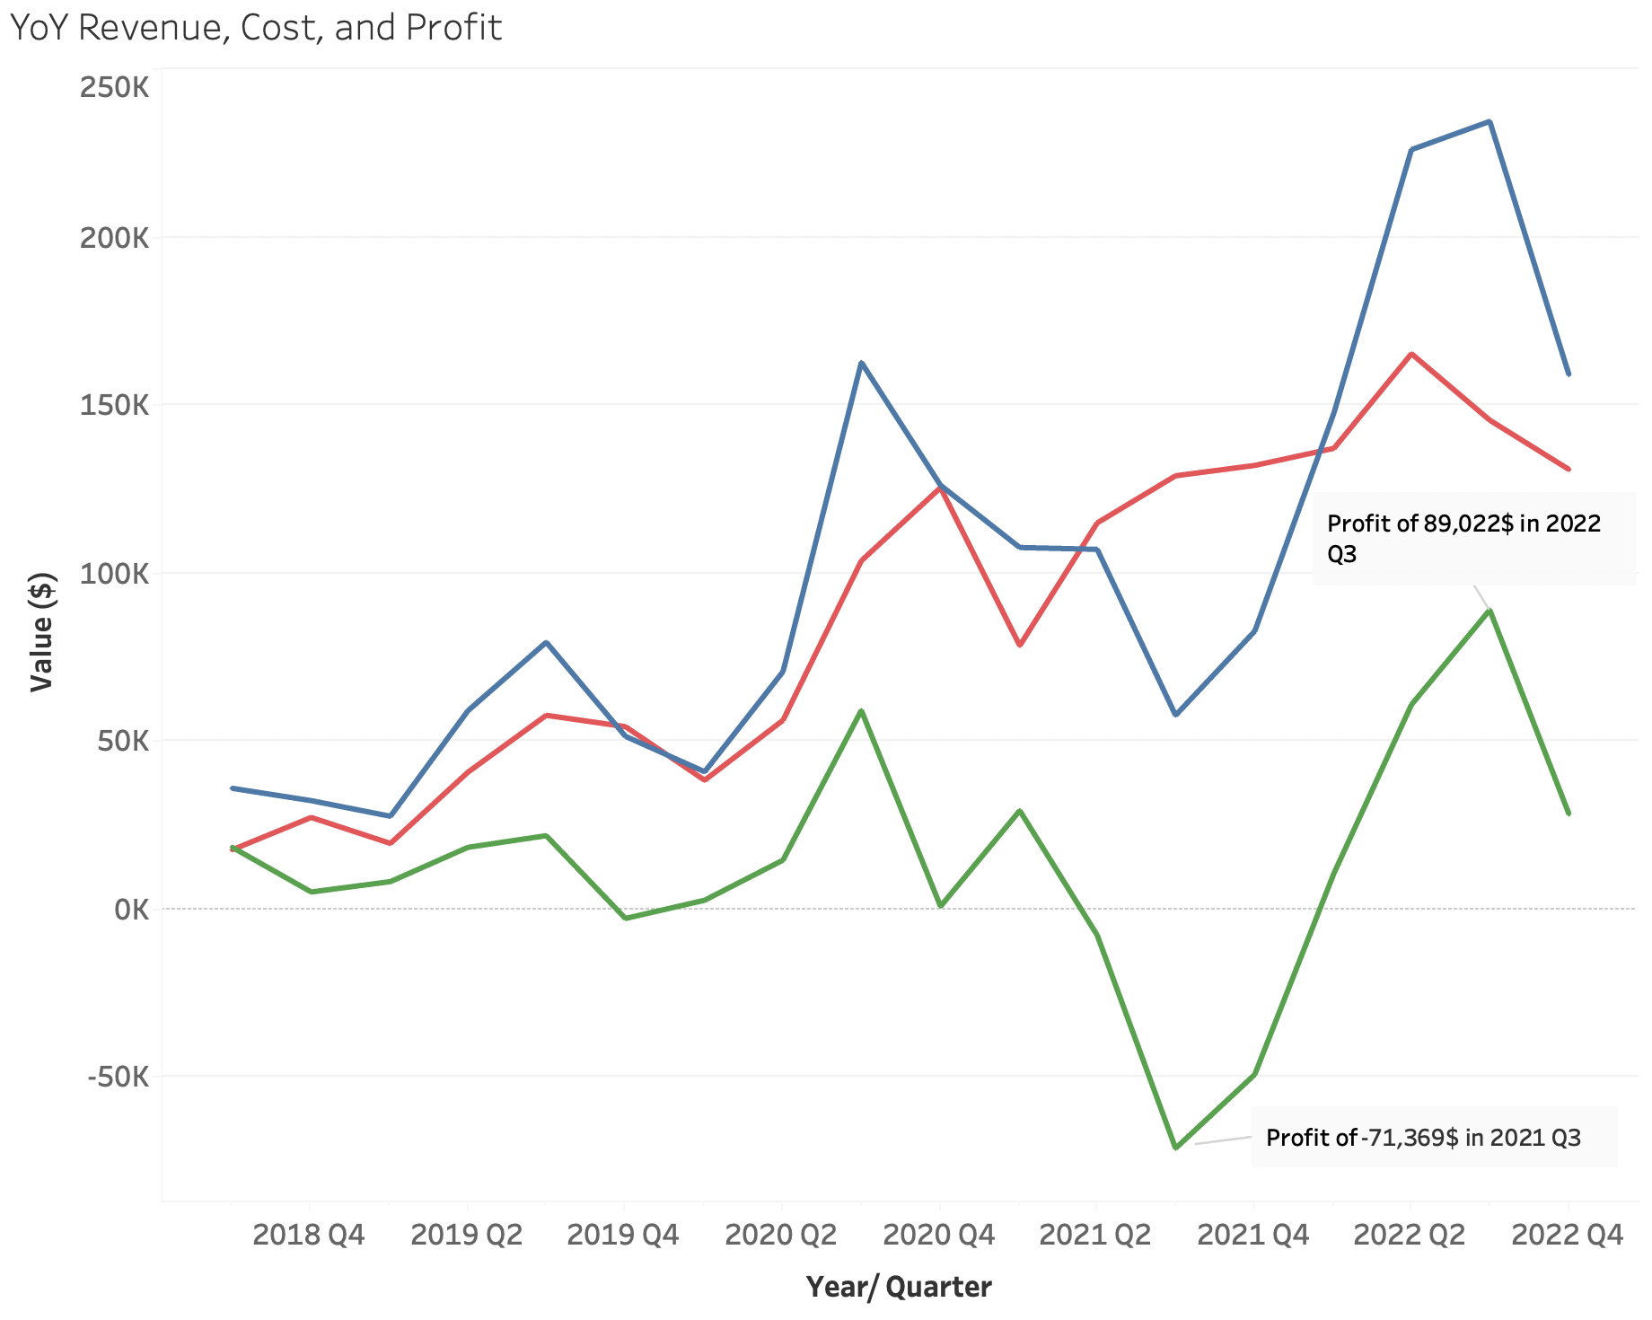
Financial Performance: Analyzing Revenue, Cost, and Profit for GI Junk (2018-2022)
GI Junk’s revenue grew 3.5 times from 2019 to 2022
While costs have been on the rise since 2021, reduction in revenue in the year 2021 led to a strong decline in profit in this period
A strong increase in revenue in 2022, showcased the highest profit over the years for GI Junk

Slide 20
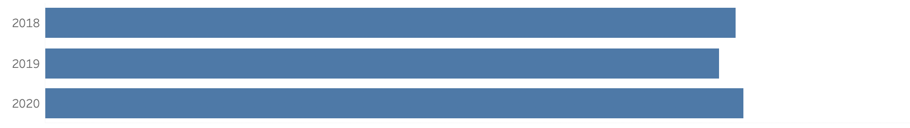
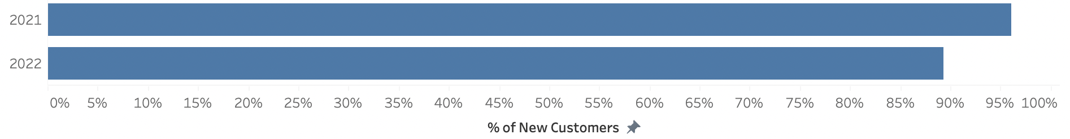
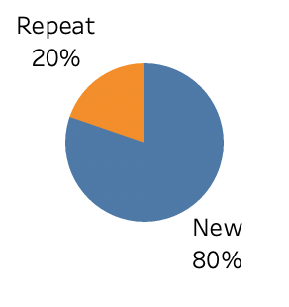
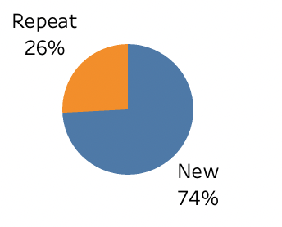
Revenue Breakdown: Analyzing New vs. Repeat Customers (2018-2022)
While the proportion of repeat customers has mostly increased over the years, they still form a small portion of the overall client base for GI Junk
It is observed that revenue per repeat customer is higher than the revenue per new customer
% count of repeat & new customers
% Revenue from repeat & new customers
100% indicates the number of clients (2021-2022): 4263
100% indicates the revenue of clients (2021-2022): 1 million $

Slide 21
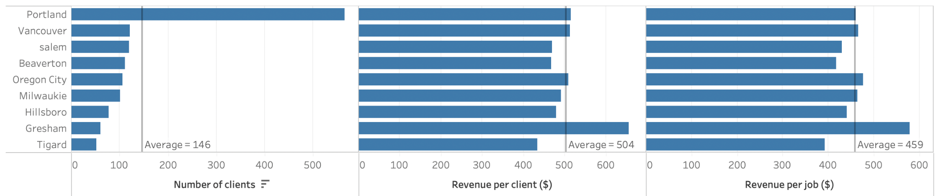
Revenue Breakdown by cities
While a major section of GI Junk’s customers are from Portland, the revenue per client across these cities as well as the revenue per job is consistent across the cities
Gresham exhibits the highest revenue per client as well as revenue per job

Slide 22

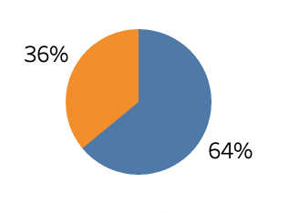
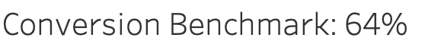
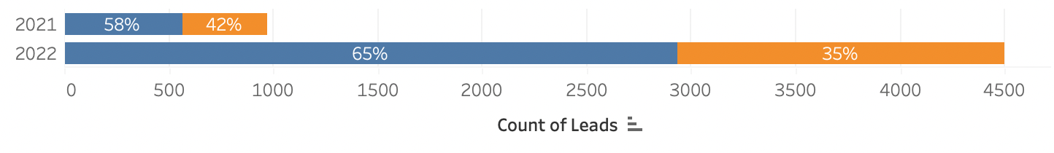
Analyzing Customer Acquisition (2021-22)
While GI Junk has invested strongly in generating leads for new customers, we observe that only around 62% of the customers approached proceed with a work order
The conversion rate for GI Junk increased from 58% to 65% from 2021 to 2022

Slide 23
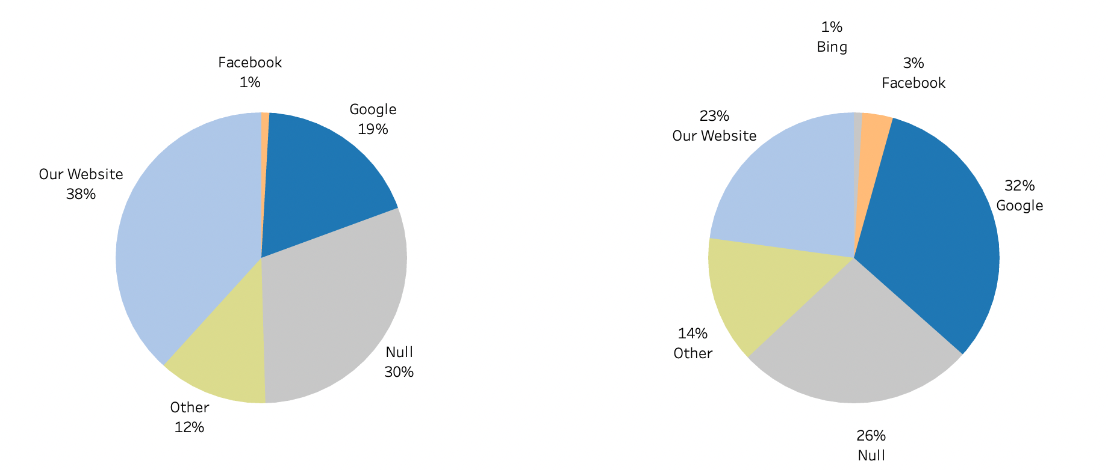
Analyzing Distribution of Leads across Sources (2021-2022)
100% indicates the number of leads in 2021 i.e., 974
100% indicates the number of leads in 2022 i.e., 4497
2021 Leads Total
2022 Leads Total
Note:
‘Google’ source includes Google Pay per Click, Google Local Service Ads and organic marketing of Google
‘Facebook’ includes Facebook Paid Advertising and Facebook Organic marketing
‘Bing’ includes Bing Pay per Click and Organic marketing
‘Other’ includes all other digital marketing and traditional marketing

Slide 24
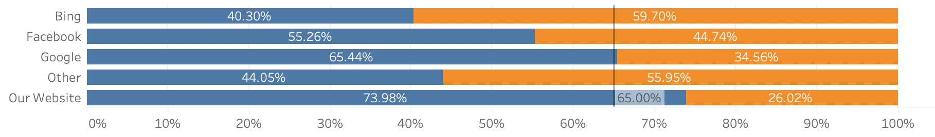
Websites by Conversion Rates (2021-2022)
It is observed that the conversion rate is the highest for GI Junk Website followed by Google
Facebook and Bing have lower conversion rates compared to the benchmark
% of Total Leads

Slide 25

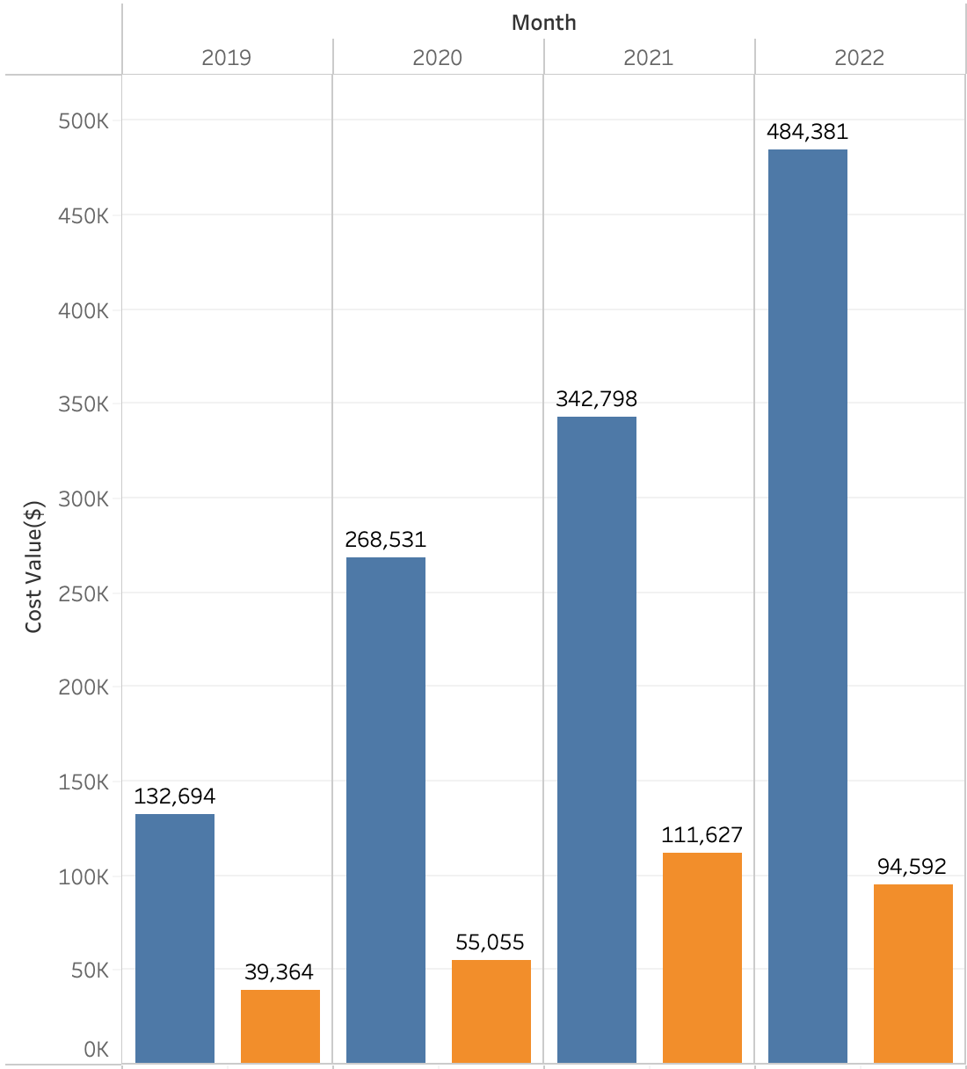
Cost Breakdown: Analyzing COGS and Marketing Spending (2019-2022)
Costs have been on the rise over the years for GI Junk with both COGS and Marketing Spend increasing for most of the years since launch
COGS forms a significant proportion (75-80%) of the costs incurred by GI Junk over the years, reflecting its dominance as a cost driver. We assume that employee costs are a predominant component of COGS
Note: COGS: Cost of Goods Sold

Slide 26
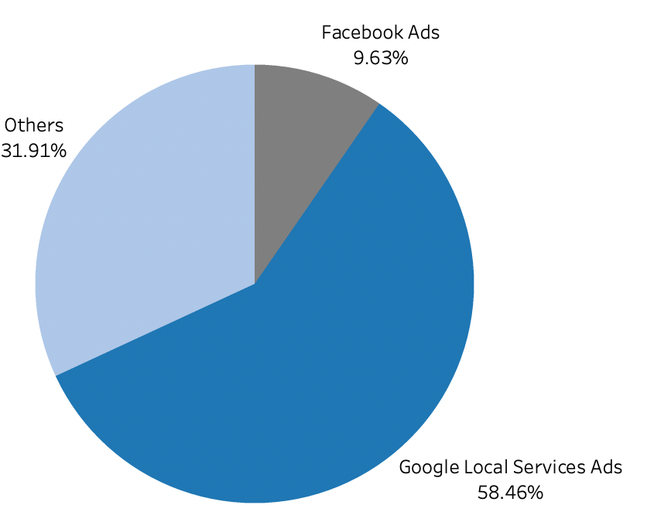
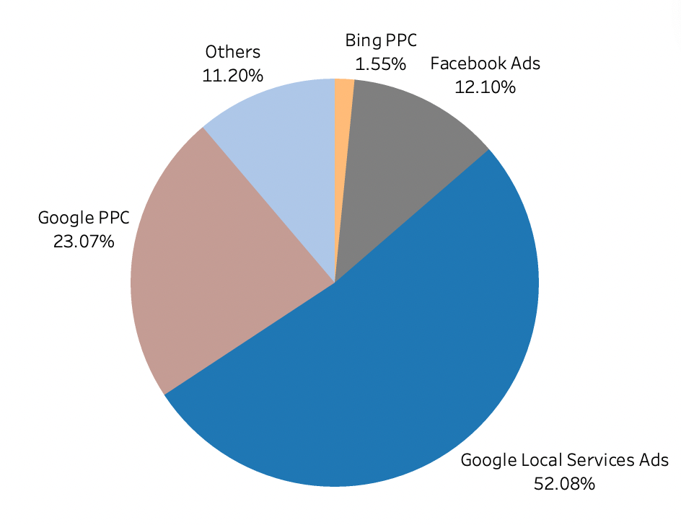
Analyzing Marketing Cost: Cost Incurred in Paid Sources (2021-2022)
Total Cost 2021: $111,627
Total Cost 2022: $94,591
2021
2022
Facebook Ads, Google PPC, Google Local Services Ads, & Bing PPC collectively contributed to 89% of the total cost incurred in 2022
Reduced costs by 6% in Google Local Services Ads and 21% from other sources
New Google PPC & Bing PPC services introduced, accounted for 23% & 2% respectively
The cost of Facebook Ads increased by 3%, underscoring the need for ongoing cost management and optimization strategies
In Q1 2021, GI Junk started investing in Google Local Services Ads
Google Local Services Ads with around 60% accounted for the largest share of the total cost incurred
Note: Other Paid Sources include Advertising & Marketing, Advertising/Promotional, Digital Marketing, Graphic Design, Lead Generator, Paid Networking Groups, Pay Per Leads, Print/Promo, Television

Slide 27

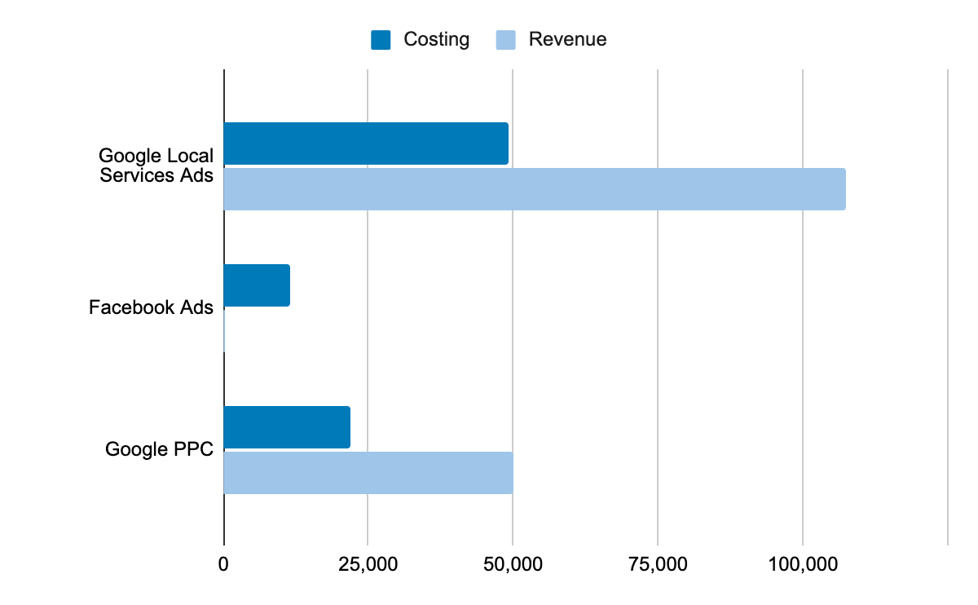
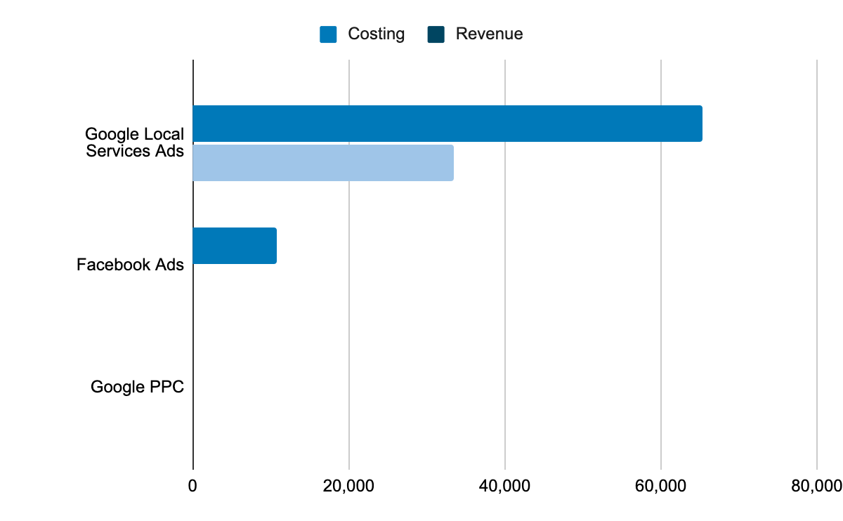
Analyzing Paid Sources (2021-2022)
200%
2021
2022
About $65K Cost was incurred to introduce Google Local Services Ads in 2021 but GI Junk beared loss of about 49% of total absolute revenue.
About $11K Facebook Ads was incurred to introduce the Facebook Ads in 2021,but didn’t result in any revenue.
A 6% decline in the costing for Google Local Services Ads from year 2021 to 2022 shows a tremendous 200%+ increase in total absolute revenue incurred from Google Local Services Ads.
Introduction of new Google PPC shows 45% profit to GI Junk.
Again Facebook Ads resulted again in no revenue for the business.
Indicates the growth rate in revenue from 2021 to 2022

Slide 28
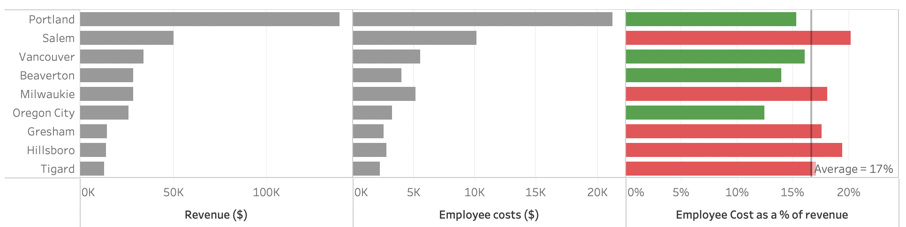
Analyzing Employee Costs (2021-2022)
We observe that around 15% of the total revenue accrued across the top cities by GI Junk is being spent as employee costs
Cities such as Salem, Milwaukie, Gresham, Hillsboro, and Tigard incur higher than average employee costs as a proportion of the overall revenue generated across these cities
Analyzing the cost incurred for these cities will be essential for resource allocation and expansion strategies for GI Junk
Note: Considering only hourly paid employees here since their count is more crucial to resource optimization

Slide 29
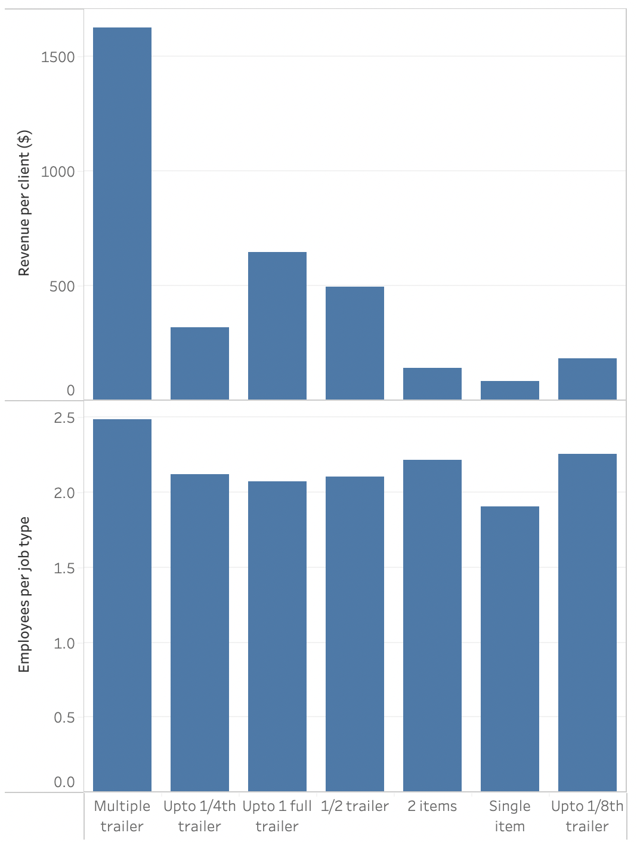
Analyzing Employee Distribution across Job Types (2021-2022)
A large section of GI Junk’s revenue is obtained when large orders involving multiple trailers are sought by customers
Each job type on an average involves 2 employees across all the types of jobs sought by customers

Slide 30
Next Steps
The team will explore ways to reduce costs within the current business operations through means such as resource (employees and trucks) optimization/ allocation
Determine ways to improve channel optimization and marketing strategies to reduce costs
Identify ways to expand GI Junk’s current operations while seeking ways to improve customer retention

